Slide 1
Trade Networks
600 - 1450 CE

Slide 2
Effect of Trade
Altered the habits of consumption
Encouraged specialization of labor
Means of social mobility or a way for elites to distinguish themselves
Spurred creation of states
Created a problem for government--Who should control trade?

Slide 3
Trade More Than Goods
Religious Ideologies
Technological Innovations
Disease
Plants and Animals

Slide 4
Silk Roads: Exchange Across Eurasia

Slide 5
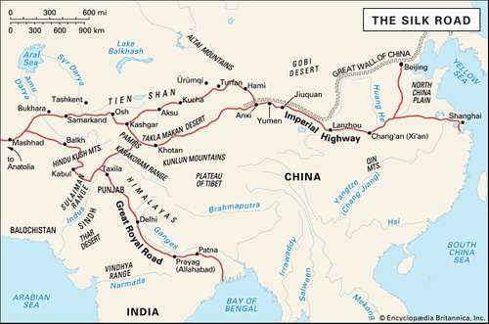
“relay trade” goods are passed down the line
provide unity and coherence to Eurasian history

Slide 6
Evolution of the Silk Roads
Pastoral people trade for products of the steppes [hides, livestock, wool, amber] for ag. products and manufactured goods
Classical Period: security of large empire = increase in trade
14th and 15th Century - Mongols unite almost entire area

Slide 7
Goods in Transit

Slide 8
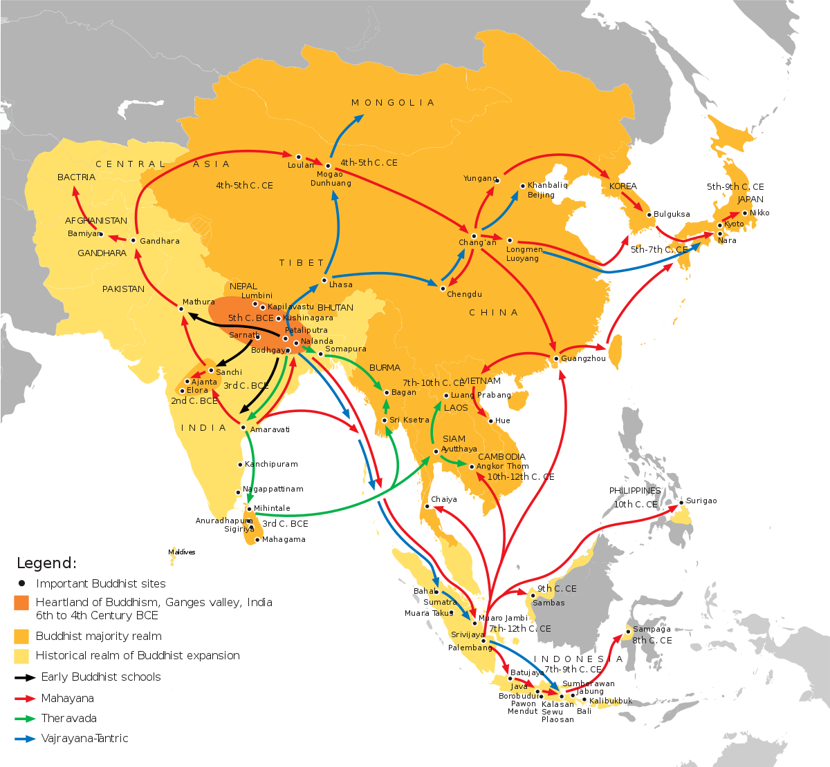
Spread of Buddhism Along the Silk Roads

Slide 9
Buddhism
Monasteries--convenient and comforting places to stop
Spread less rapidly in pastoral areas (lack of written lang.)
Changed as it spread-- Theravada v. Mahayana
From India to Central and East Asia by merchants
In West - blocked by Zoroastrianism but Buddhism embraced in Oasis cities
Songdians--Central Asian merchants; dominated silk trade; translated Sanskrit into Chinese

Slide 10
Disease
Cities better prepared to manage outbreaks
Smallpox, measles, plague, malaria
Bubonic Plague: 534-750 CE intermittent outbreaks
13-14th Cen: Black Death - killed up to half of Europe
Exposure over time given Europeans a long run advantage

Slide 11
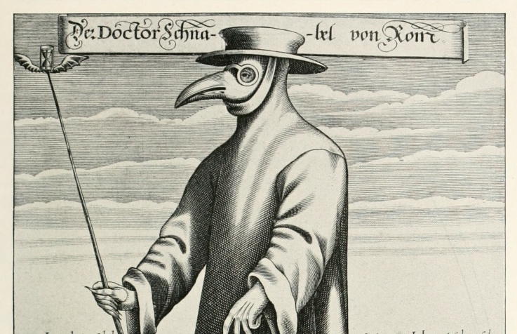
Woodcut of Plague Doctor

Slide 12
Sea Roads: Exchange
Across the Indian Ocean

Slide 13
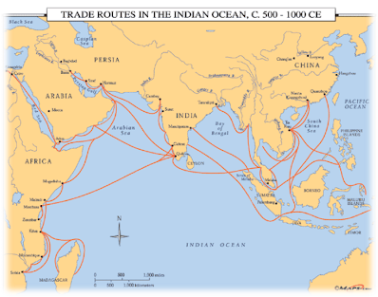
Connected people across the Eastern Hemisphere
Continued trade by Phoenicians, Greeks, Romans

Slide 14
Evolution of the Sea Roads
1000 CE Venice: center of commercial network
Mediterranean, Black Sea, Atlantic Coast
Controlled flow of imported goods and resold throughout Mediterranean Coast
Linked Mediterranean to Indian Ocean Trade

Slide 15
Goods in Transit

Slide 16
Transoceanic Trade Routes
Less expensive transport costs than Silk Road
Carry larger and heavier cargoes than camels
More bulk goods for mass markets (v. luxuries)

Slide 17
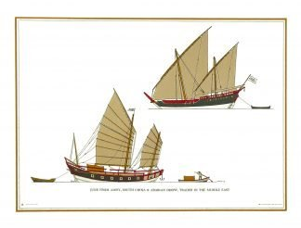
Transoceanic Trade Routes
Monsoons
Better sails
New ships (Chinese junks, Indian/Arab dhows)
Compass

Slide 18
The Indian Ocean World
Trade between a network of towns and cities = urban centers
Malay sailors with double outrigger canoes Madagascar
Austronesian language and crops (banana, coconut, taro) spread to mainland Africa
Merchants from Roman World (Greeks, Syrians, Jews) est. settlements in South India and East Africa
India is the fulcrum: spread of Hinduism and Buddhism and spread of politics to Southeast Asia

Slide 19
Catalyst For Change
Southeast Asia
New cities, states, & kingdoms
Srivijaya: Malay Kingdom, dominant choke point 670-1025
Gold, spices, taxes on passing ships
Spread of Indian culture: Hinduism and Buddhism
Process of “Indianization”
East Africa
Swahili civilization (8th Cen): commercial city-states from Somalia to Mozambique
Rise of Islam = increase in trade; local rulers profited + merchant class arose
1000-1500: civilization flourished on the coast (cosmopolitan cities) v. pastoralism in interior
Swahili: Bantu lang. written with Arabic

Slide 20
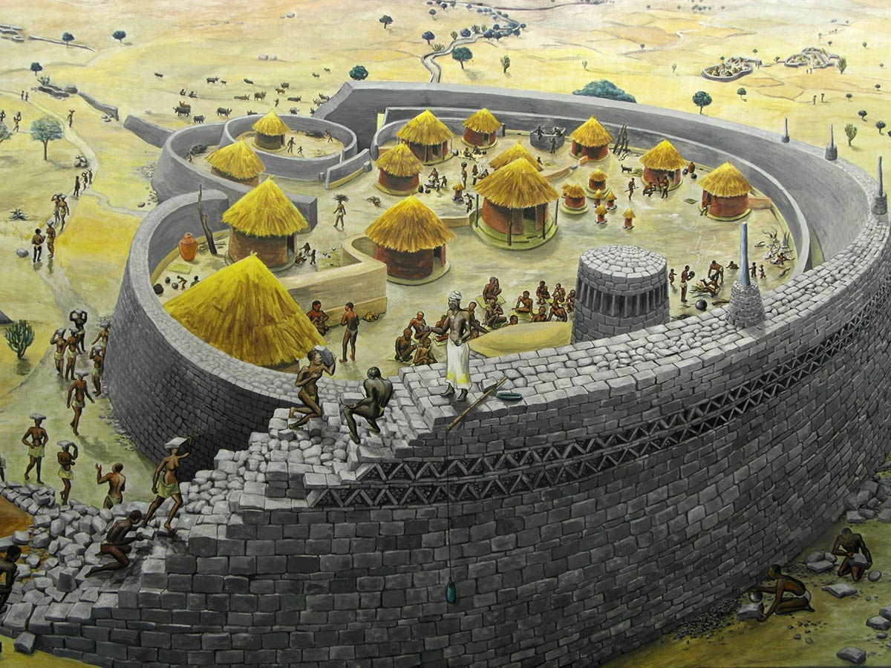
The Great Zimbabwe

Slide 21
Sand Roads:
Exchange
Across the
Sahara

Slide 22
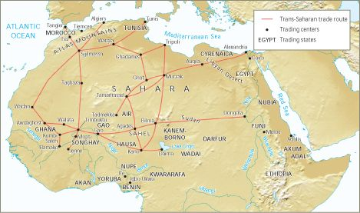
Linked North Africa & Med. World with interior West Africa

Slide 23
Goods in Transit
North African Coast: cloth, glassware, weapons, books, manufactured goods
Sahara: copper & salt and dates from the oases
Sub-Saharan: grain from the savanna grassland and root/tree crops from the forest

Slide 24
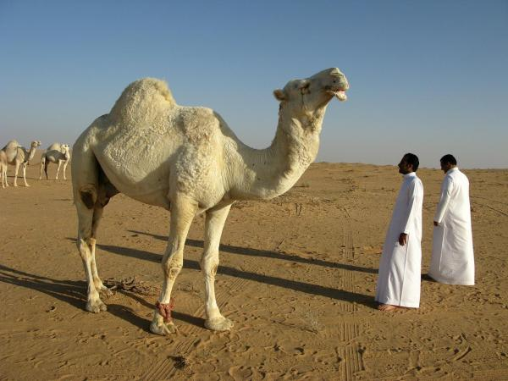
Arabian Camel

Slide 25
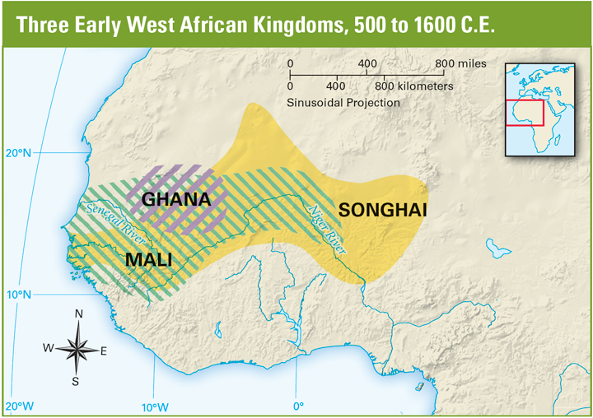
Gold, salt, and slaves

Slide 26
West African Kingdoms
States: Shana, Mai, Songhay
Monarchies
Varying levels of complexity
Wealth
Social hierarchies
Cities: Jenne, Timbuktu, Gao
Cosmopolitan
Craftspeople
Manufacturing
Slaves
non-Islamic, stateless peoples from the South
1100-1400: 5,500 slaves/year

Slide 27
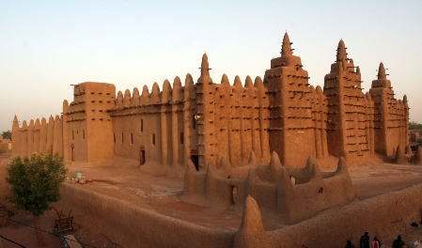
The University of Timbuktu in Mali

Slide 28
Less connected
Panama blocked trade
Climate slowed spread of agriculture
“Loosley interactive web”: maize, ball games, pottery
Slow diffusion
The Americas

Slide 29
Three regions with interregional trade:
Cahokia
Peru
Mesoamerica

Slide 30
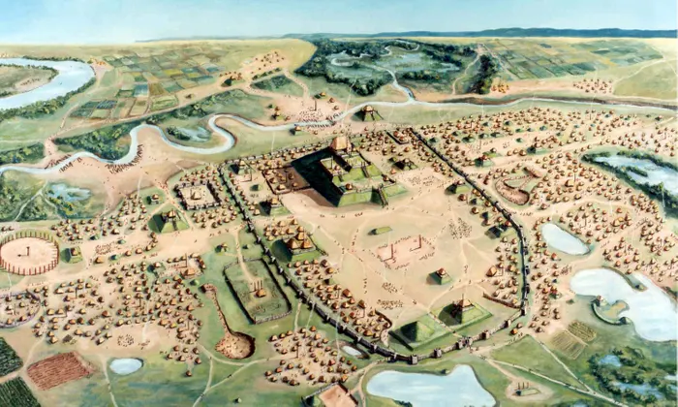
Cahokia

